Slide 1


CIT 261
Mobile Development
Objects
JSON
XMLHTTPRequest
by Rafael Ferraz

Slide 2

Objects

Slide 3
JavaScript Properties
The syntax for accessing the property of an object is:
objectName.property // person.age
or
objectName["property"] // person["age"]

Slide 4
Inheriting "methods"
var o = {
a: 2,
m: function() { return this.a + 1; }
};
console.log(o.m()); // 3
// When calling o.m in this case, 'this' refers to o
var p = Object.create(o);
// p is an object that inherits from o
p.a = 4;
// creates an own property 'a' on p
console.log(p.m()); // 5

Slide 5
Inheriting "methods"
function Graph() {
this.vertices = [];
this.edges = [];
}
Graph.prototype = { addVertex: function(v) { this.vertices.push(v); } };
var g = new Graph();
// g is an object with own properties 'vertices' and 'edges'.
// g.[[Prototype]] is the value of Graph.prototype when new Graph() is executed.

Slide 6
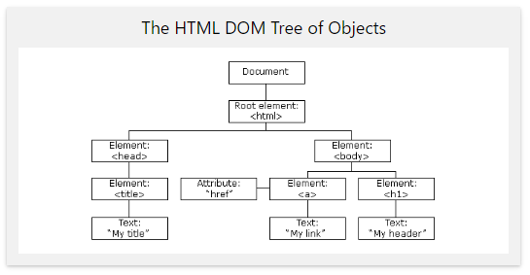
The HTML DOM (Document Object Model)
When a web page is loaded, the browser creates a Document Object Model of the page.
The HTML DOM model is constructed as a tree of Objects:
It defines:
The HTML elements as objects
The properties of all HTML elements
The methods to access all HTML elements
The events for all HTML elements
In other words: The HTML DOM is a standard for how to get, change, add, or delete HTML elements.
document.getElementById("demo").innerHTML = "Hello World!";

Slide 7
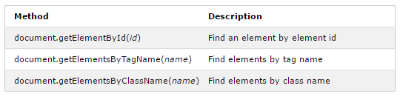
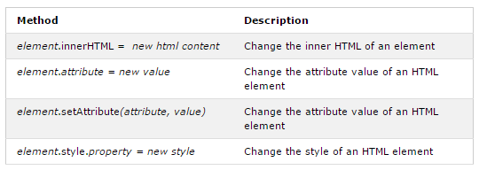
The HTML DOM (Document Object Model)
Finding HTML Elements
Changing HTML Elements

Slide 8

JSON

Slide 9
JSON
JSON, or JavaScript Object Notation, is a minimal, readable format for structuring data. It is used primarily to transmit data between a server and web application, as an alternative to XML
var myJSON = '{ "name":"John", "age":31, "city":"New York" }';

Slide 10
JSON
JSON.stringify turns a Javascript object into JSON text and stores that JSON text in a string.
JSON.parse turns a string of JSON text into a Javascript object.
var myObj = { name:"John", age:31, city:"New York" };
var myJSON = JSON.stringify(myObj);
document.getElementById('json').innerHTML = myJSON;
var myJSON = '{ "name":"John", "age":31, "city":"New York" }';
var myObj = JSON.parse(myJSON);
document.getElementById("demo").innerHTML = myObj;
{"name":"John","age":31,"city":"New York"}
typeof(myJSON) = string
typeof(myJSON) = object

Slide 11

AJAX

Slide 12
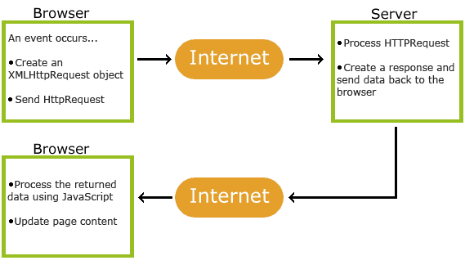
AJAX
AJAX = Asynchronous JavaScript And XML.

Slide 13
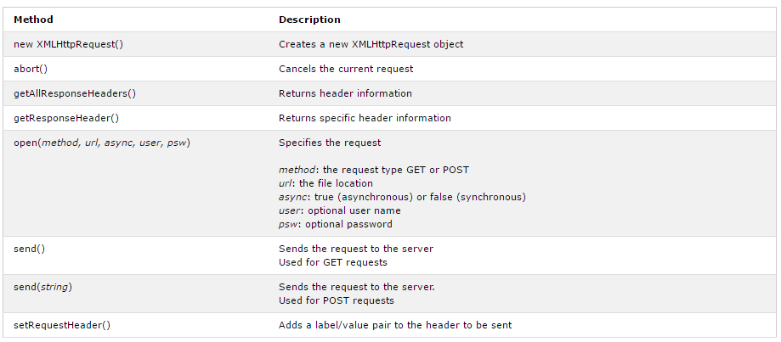
AJAX
The XMLHttpRequest object is used to exchange data with a server behind the scenes. This means that it is possible to update parts of a web page, without reloading the whole page.
variable = new XMLHttpRequest();

Slide 14
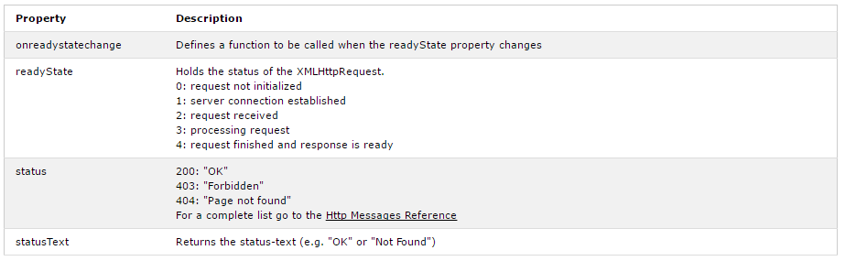
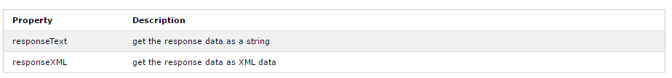
AJAX

Slide 15
CIT 261
Mobile Development
Objects
JSON
XMLHTTPRequest
THE END!
by Rafael Ferraz

